Slide 1
Software Testing
Test Processes
Presented By
Ning Chen, Ph.D.
Professor
Department of Computer
Science
California State University,
Fullerton
© Ning Chen, 2018
*

Slide 2
Module Objectives
This module focuses on understanding test processes

Slide 3
Motivation
Logical question:
  Is knowing all the test techniques enough in achieving high quality software?
  Our answer is no.

Slide 4
Why?
In the old good days when software is not that big and complicate the development could be effectively done with a handful of hotshot developers. A tester probably could apply the techniques from what he/she learned in the previous chapters without bothering his colleagues (fellow developers/tests) too much. Some occasional informal chats on issues would be enough.

Slide 5
Why?
Time flies and size of software product grows. Nowadays, most of the commercial software products are big and complicate. People (stakeholders) who involve software project are no longer just developers and testers. Customers, managers, and users are all becoming an essential piece of a much bigger puzzle. Failing to communicate among large number of stakeholders, failing to following things through, failing to have a systematical way of testing things, etc., make us realize that good quality of software cannot be achieved by knowing the test techniques alone.

Slide 6
Why?
Having a good test process plays an equal, if not more important, role in achieving high quality software.

Slide 7
What is process?
A dictionary definition gives the following for the word process: a series of actions or steps taken in order to achieve a particular end. [dictionary.com] If you simply insert the term test to it, it ends up with a very reasonable, good enough statement on the term test process: a series of test actions or test steps taken in order to achieve a particular end.

Slide 8
What is test process?
Well, people who promote International Standard ISO/IEC/IEEE 29119 Software and systems engineering - Software testing [ IEEE], believe that there are not just one test process, but many test processes and all those test processes fall into one of the three main categories, Organizational Test Process, Test Management Processes and Dynamic Test Processes.

Slide 9
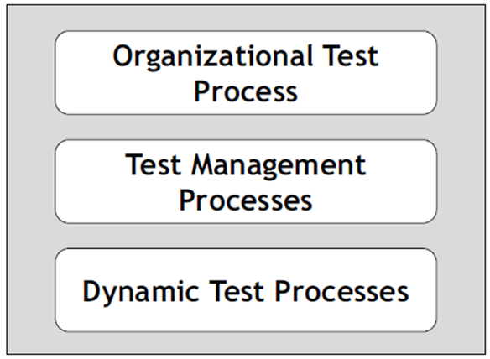
Test Processes (IEEE29119)

Slide 10
Learning IEEE std 29119
A bit hard – it has five parts and 488 pages in total (also probably $100 a copy too).

Slide 11
Our approach (the 1st categority)
Without reading the whole ISO/IEC/IEEE 29119 (it has five parts and 488 pages in total) one probably can guess that the first category, Organizational Test Process, is an organization level process that addresses the high-level, over-all issues, like test policy, test goals, etc.

Slide 12
How about the 2nd and 3nd category?
The third category, Dynamic Test Processes, is a bit hard to guess. It turns out that in software testing, it is not unusual to have two distinct types of activities. One type of activity involves, say, developing test scripts, executing testing programs, etc. Another type of activity probably does not relate to developing and running/executing testing programs, but, relate to, say, writing up a test plan, monitoring and control what needs to be done. ISO/IEC/IEEE 29119 calls the former as Dynamic Test Processes probably due to the fact that this type of activity involves the running/executing of program under test which it is a bit dynamic. As for the latter, one may suspect that Static Test Processes probably is a good name, since it is an antonym.

Slide 13
How about the 2nd and 3nd category?
Well, ISO/IEC/IEEE 29119 did not pick that name. The ISO/IEC/IEEE standard called it Test Management Processes. It is not a bad name, in our opinion, since the static type of activity, test planning, monitoring, and controlling, is a form of managing. Calling it Test Management processes may not be a bad idea. Anyway, the name Static Test Processes itself is not a perfect name either.

Slide 14


